Slide 1



Semantic UI
Manal Shihadeh and Thalia Cochrane

Slide 2


Introduction
We were given the framework Semantic UI to work with and to help us in designing a website layout with the design principles provided through the framework. We were to use at least 3 components such as navigation bars and cards to enhance the functionality of the website and it aesthetics. For content we were to use the framework’s grid system.

Slide 3

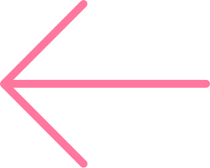
About the Framework
When trying to download the tools for the framework, it used out of date tools that ran errors when trying to install them. The files kept coming back as depreciated and was overly complicated and time consuming to figure out. Instead we had to use a Semantic UI extension on visual studio code to get the framework to work.
While installing the framework wasn’t easy, it was easier to implement the different components and features into the document. It was difficult to change the sizing and style of some elements as well.

Slide 4

Elements
The elements we used for out website were buttons and different headers such as sub headers, icon headers, and block headers. We also used images, and image cards, and menus.
We used the different classes to change sizing, colors of backgrounds and fonts, and to change alignments as well.

Slide 5
Format
For formatting content, we used a variety of ways to format images such as, fluid image, centered align, and card images. We also used containers, segments, columns, and rows.

Slide 6

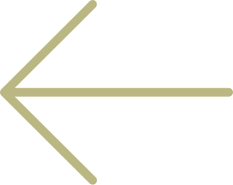
Home Page
For the homepage , we used a block header at the top of the webpage to seperate the heading from the rest of the webpage.
Below that we used a menu to navigate to the different pages. For the main image we used a container around it to keep the background from spilling to rest of the page.
Below that are columns and segments to seperate the three information pieces.
There is also buttons that are being used as headings for these three columns.
The headings themselves link to an anchor on the other pages.
For summarized information we used cards with images that link to corrosponding pages as well for more specific navigation.

Slide 7

Other Pages
For the rest of the pages we left the header and menu at the top, same as the home page, just with the active item being for the corresponding page. For the main image, we used a fluid image to fit to the site, then below that is a header and segment for information.
After that there is a icon header with an anchor point that links from the home page to bring it to this point.
Next is centered images with a container background to keep the background from going anywhere else.

Slide 8
Advantages
The advantages of using Semantic UI is that it makes designing a webpage easier and allows you to not worry about formatting over different devices. It also allows for easy customization with the theming system and variety of componenets

Slide 9
Conclusion
Overall, Semantic UI is a fairly easy to use framework after you get past the downloading difficulties, at least on windows. There is a variety of components to use to customize your website and the elements pulled fromed the framework are easy to customize themselves as well, whether you want to change the color, size, or positioning.

Slide 10
Fin.

